Slide 1

Phishing Website detection using Deep Neural Network (NLP)

Slide 2
Phishing Website detection using Deep Neural Network (NLP)
A typical Phishing Attack!
A victim opens a compromised link that poses as a credible website. The victim is then asked to enter their credentials, but since it is a “fake” website, the sensitive information is routed to the hacker and the victim gets ”‘hacked.”
-1-

Slide 3
Phishing Website detection using Deep Neural Network (NLP)
How to identify a phishing URL?
Is it misspelled?
Is it Pointed to the wrong top-level domain?
Does one part seems real and one part seems fake?
Is it incredibly long?
Is it just an IP address?
Has a low PageRank?
Has a young domain age?
Ranks poorly on the Alexa Top 1 Million Sites?
-2-
Notes:
PageRank is an algorithm used by Google Search to rank web pages in their search engine results.

Slide 4
Phishing Website detection using Deep Neural Network (NLP)
Two different approaches were tried out for the project:
1. Deep Neural Network
Using a pre-processed dataset from Kaggle.
To compare the performance of the model, Logistic Regression and Multilayer perceptron have been applied.
2. Deep Neural Network + NLP
By focusing just on address bar, a NLP model has been applied
-3-

Slide 5
Phishing Website detection using Deep Neural Network (NLP)
What does URL features extraction mean?
And why we have used preprocessed Dataset?
Address Bar-Based
Adding a prefix or suffix separated by (-) to the domain
Having sub-domain and multi-sub-domains
Existence of HTTPS
Domain registration age
Favicon loading from a different domain
Using a non-standard port
Abnormal Features
Loading images loaded in the body from a different URL
Minimal use of meta tags
The use of a Server Form Handler (SFH)
Submitting information to email
HTML and JavaScript-Based Features
Website forwarding
Status bar customization typically using JavaScript to display a fake URL
Disabling the ability to right-click so users can’t view page source code
Using pop-up windows
Domain-Based Features
Unusually young domains
Suspicious DNS record
Low volume of website traffic
PageRank, where 95% of phishing webpages have no PageRank
Whether the site has been indexed by Google
-4-
Notes:
Extracting features from address bar is easy with some codings in python but features extraction based on Javascript and domain is not possible only with coding, but it also needs other software. We tried to add some other features from this list to our dataset like google index, if the url submitted to mail and having subdomain. Two of them were added successfully but google index not, although we have spent 2 days working on that.

Slide 6
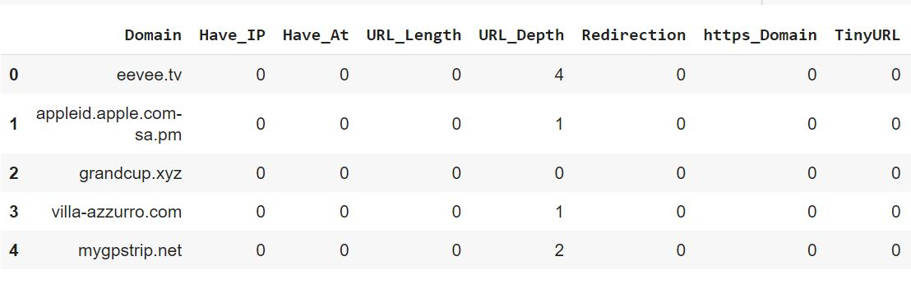
Phishing Website detection using Deep Neural Network (NLP)
A dataset with 0 and 1!
Figure 1.1: Some extracted features with their values
-5-
Notes:
After extracting features, conditions are applied to the result.
0 is assigned to real websites and 1 to fake. For ex: if there is @ in the address bar then it’s 1 which means phishing otherwise it’s 0 which is real
URL length: if it’s more than 54 character, it’s phishing otherwise it’s 0 real
The only exception in this dataset is URL Depth which has number in range 0 – 2000. later we normalize the data to have same scales of values.

Slide 7
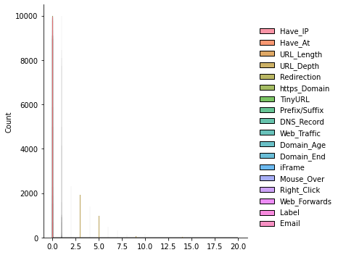
Phishing Website detection using Deep Neural Network (NLP)
First Approach:
Using a Deep Neural Network
The pre-processed dataset from kaggle consisted of 17 features with 10000 URLs
Figure 1.2: Graphical representation of the Features
-6-
Notes:
10000 equally distributed for phishing and real

Slide 8
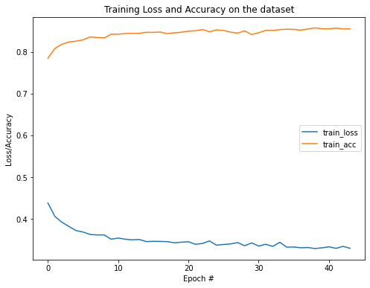
Phishing Website detection using Deep Neural Network (NLP)
Model was trained with Logistic Regression and Multilayer perceptron,
Training accuracy: 86%
Test accuracy: 85%
But the model was not really learning so much!
Next step was to find the problem and increase the training and test accuracy
In order to do this more features needed to be extracted from the URL’s
Two more features were added to the dataset namely the existence of subdomains and submitted to email.
Still the training accuracy of the model was not increased
Figure 1.3: Training loss and accuracy on the dataset
-7-

Slide 9
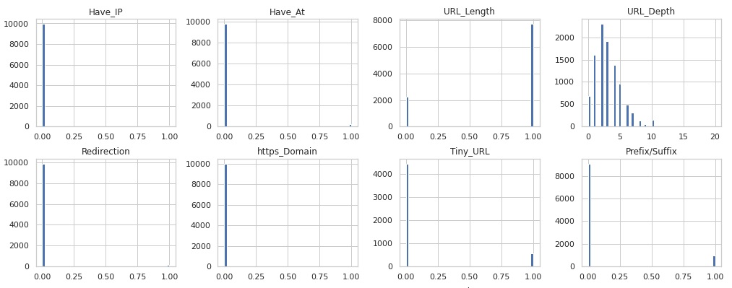
Phishing Website detection using Deep Neural Network (NLP)
Reason for the non-increasing accuracy was :
Most of the Feature values are binary and the model was not learning from them
Figure 1.4: Plots of the training data distribution
-8-
Notes:
We could solve the mistake and improve the model with this approach, but then we found out even if the model works fine, to deploy the model, we need all feature extraction codes and practically there is no point in working with preprocessed dataset. For learning aspect it was ok but it was not possible to really test the model with a URL out of our dataset. So we shifted to the next approach.

Slide 10
Phishing Website detection using Deep Neural Network (NLP)
Second approach: Deep Learning Neural Network + NLP
This NLP or Natural Language Processing model emphasis more on “words/phrases” and “how they are grouped together” in a URL, different to the previous model which depend on specific features of URL’s.
This model make use of “Tokenization” which will separate a piece of text in small units of tokens.
A “token” could be a word, a character or sub words.
This approach was able to obtain:
Training accuracy of 98%
Testing accuracy of 97%
-9-

